Slide 1
Agriculture & Industries

Slide 2
Agriculture & Industries
Factors affecting
Physical
Economic
Human
Environmental problems associated with agriculture
Loss of agricultural productivity because of chemical fertilizers, mining, quarrying
Land degradation is a process in which the value of biophysical environment is affected by a combination of human induced processes acting upon the land.
Land degradation due to deforestation, poor farming practices, over grazing, urban sprawl, quarrying of stones, sand, minerals, harvesting by heavy equipments, monoculture, dumping of non biodegradable trash.
Effects of land degradation
Population pressure
Climate change

Slide 3
Desertification
In 1977, in Nairobi, the first United Nations Conference on desertification defined desertification as ‘the reduction or destruction of the land’s biological potential, finally resulting in the appearance of desert conditions.
Causes:
Over cultivation
Over grazing
Unskilled irrigation

Slide 4
Definition
The reduction of land’s biological potential, finally resulting in the appearance of desert conditions.
Various human activities and climatic conditions convert fertile land into infertile land.
Process of land degradation in arid, semi-arid and sub-humid areas.

Slide 5
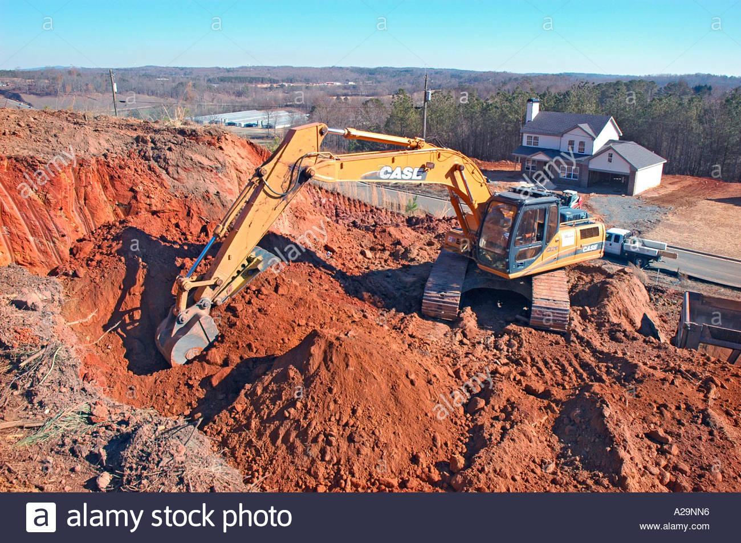
Causes
Over Cultivation
Overgrazing
Unskilled irrigation
Climate change
Deforestation
Stripping the land for resources
Natural disasters

Slide 6
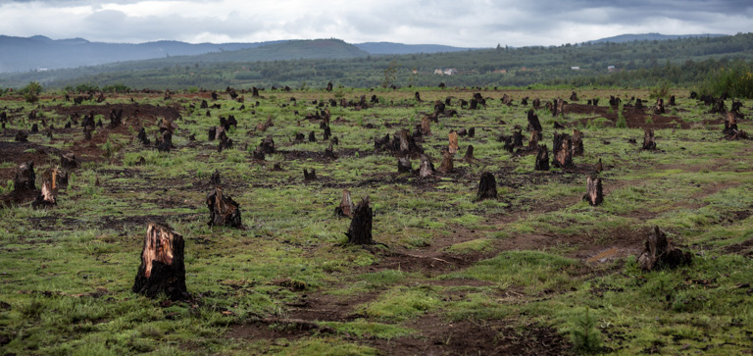
Effects
Biodiversity loss
Hunger
Poverty
Economic instability
Threatens the health and nutrition
Environmental refugees
Global climate change

Slide 7
Nairobi conference
29th August to 9th September 1977
A comprehensive Plan of Action to Combat Desertification (PACD) was adopted .
The Assembly decided, inter alia, to entrust UNEP and the Environment Co-ordination Board with the task of following up and coordinating implementation of the Plan of Action.
United Nations Conference on Environment and Development (UNCED) in June 1992

Slide 8
UNCCD
The United Nations Convention to Combat Desertification adopted in countries of serious drought and/or desertification, Particularly in Africa (UNCCD)
The Convention, a direct recommendation of the Rio Conference's Agenda 21.
It was adopted in Paris, France on 17th June 1994
The permanent Secretariat at Bonn, Germany in 1999
To publicize convention, 2006 was declared “International year of Deserts and Desertification”

Slide 11
Effects of desertification
Loss of biological biodiversity
Loss of biomass and bio productivity.
Disturbs biogeochemical cycles.
Global climate change
Global loss of productive land resources
Economic instability and political unrest
Pressure on economy
Influx of environmental refugees
Threatens the health and nutrition intake of the people.

Slide 12
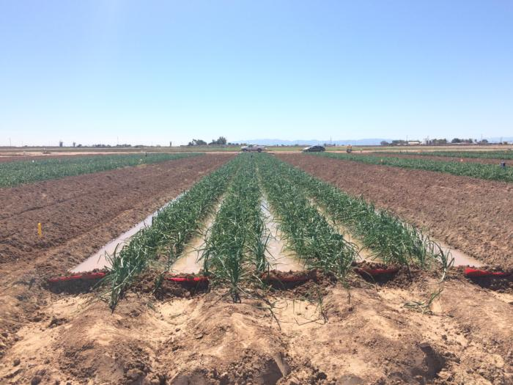
Solutions for desertification
Land and water management:
Protection of vegetative cover:
Alternative Farming
Rehabilitation efforts
Shelterbeds
Rangelands

Slide 13
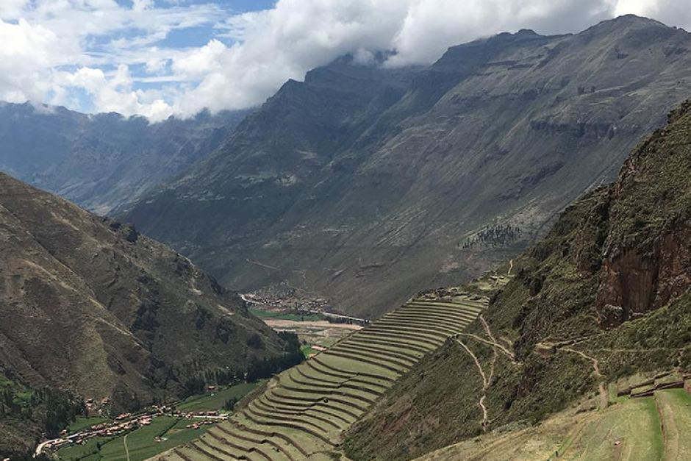
Land management (Andes)

Slide 14
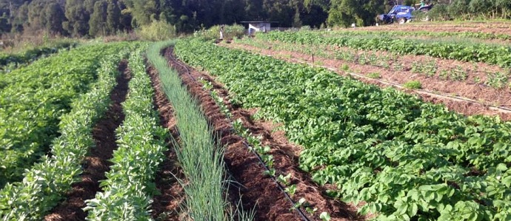
Crop rotation

Slide 15
Shelterbeds Gobi desert

Slide 16
Rangelands

Slide 18
Dhule (Maharashtra)

Slide 19
64.2 percent land under desertification.
9th in the list of worst affected areas.
No dense forest in the state.
Pressure on little patches forest.
Overgrazing, collection of firewood, illegal felling of timber, forest fires.
Forest fires by grazers, Mohua, Tendu contractors

Slide 20
Uneven food production
Climate of the areas
Government policies
Different methods of food production
Availability of land
Availability of labour, capital and fossil fuels.
E.g Uneven distribution of rice in the world
Major sources of food
Food grains= Rice, wheat, maize
Different types of fruits and vegetables
Animal products= milk, beef, mutton
Fish

Slide 21
Environmental problems due to industries
Air pollution
Water pollution
Noise pollution
Land pollution

Slide 22
Air pollution
Oxides of carbon(Carbon monoxide, Carbon dioxide)
Major source= Consumption of transport fuel, industries
Effects: Headache, nausea, vomiting, mental confusion
Oxides of sulphur (Sulphur dioxide, Sulphur trioxide)
Sources= Coal combustion, oil refineries, copper, lead, zinc smelting
Effects: Destroy leaf tissue, results in discoloration. Respiratory irritation
London smog
Oxides of nitrogen
Sources= Coal combustion, transport and industrial processes.
Effects: Formation of photochemical smog(white yellow haze)
Eye irritation and damage to vegetation.

Slide 26
Water pollution
Municipal and domestic waste
Industrial waste water
Agricultural chemicals(Fertilizers, pesticides)
Radioactive waste
Heavy metals (Minamata disease)

Slide 27
Noise pollution
Unwanted annoying sound.
Results from industries, traffic
Community noise
Three main metro cities are Mumbai, Kolkata, Delhi
Effects= affects hearing, ruptures eardrums, causes permanent hearing loss, headache, fatigue, dizziness, high blood pressure, tension in muscles, abnormal heart rhythm.

Slide 28
Land pollution
Productive to non productive land
Agents responsible are:
Deforestation
Soil erosion
Overgrazing
Mining activities
Solid waste

Slide 29
Global warming
Various human activities such as burning coal, oil and natural gas releases carbon dioxide, methane and other greenhouse gases into the atmosphere.
The greenhouse gases form a blanket around the earth, trapping heat and raising temperatures on the ground.
The period from 1991 to 1995 was the hottest five year period on record. 1988 was the hottest year in human history.
The greenhouse gases:
Water Vapour
Carbon dioxide
Methane
Nitrous oxide
CFCs
Ozone

Slide 30
Greenhouse gases

Slide 32
Effects

Slide 36
Acid rain
The term acid rain was coined in 1872. It is measured using the pH scale.
Causes:
Oxides of sulphur and nitrogen.
Organic acids and hydrochloric acid also contribute to some extent for acid rain.
The chief sources that add sulphurous and nitrogen oxides to the atmosphere are industrial emissions, fossil fuel based thermal power plants and vehicles using petrol or diesel as fuel.
Since industrial revolution, emissions of sulphur dioxide and nitrogen oxides into the atmosphere has increased.
The corrosive effects of acids was observed on the limestone and marble.

Slide 37
Types of acid deposition
Wet deposition
It occurs when any form of precipitation (rain, snow) removes acids from the atmosphere and delivers it to the Earth’s surface.
This result from the deposition of acids produced in the raindrops or by precipitation.
Dry deposition
It occurs via dry deposition in the absence of precipitation.
This occurs when particles and gases stick to the ground, plants or other surfaces.

Slide 38
Effects of acid rain
On buildings and monuments.
On streams and lakes
On aquatic organisms
On ecosystem
On forest
On human health
Damage to the built environment

Slide 39
